Slide 1
Lecture 3 Data Management, Manipulation, and Exploration with dplyr
Beckerman et al. p. 57-73

Slide 3
Using dplyr
You should do all your data manipulation in R (and none anywhere else).
This is the only way to ensure a completely reproducible workflow. You will thank yourself in 10 years; your collaborators will thank you now.
We are learning to use dplyr and its functions, rather than the classic ways of managing and manipulating data (using BaseR); the syntax of dplyr is much easier

Slide 4
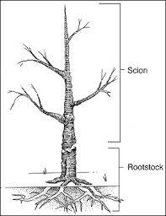
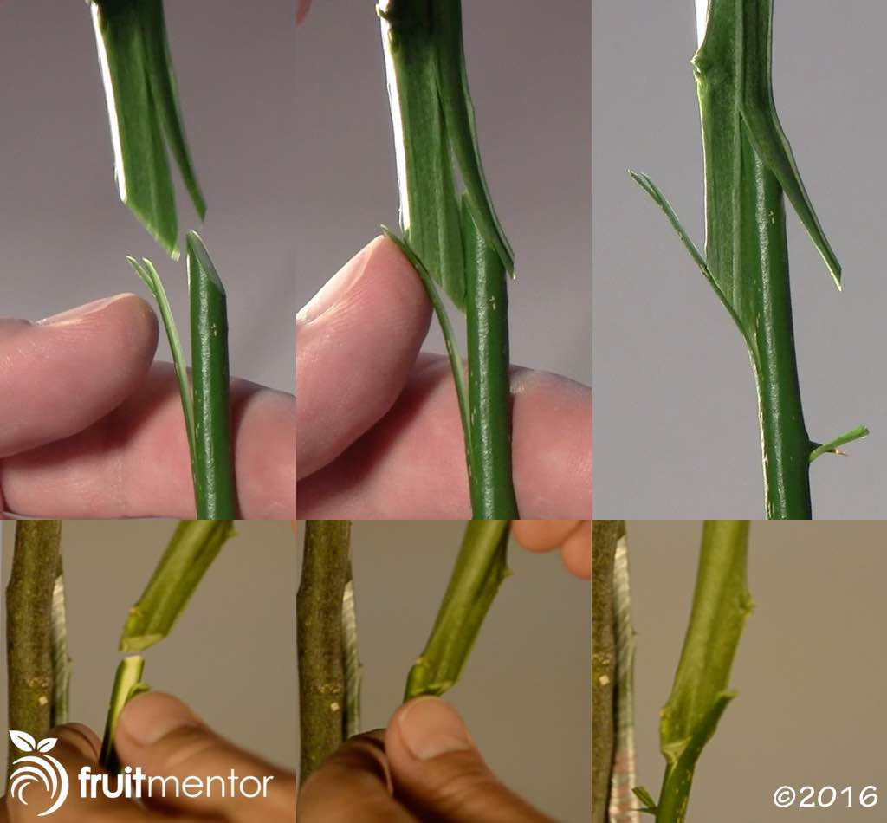
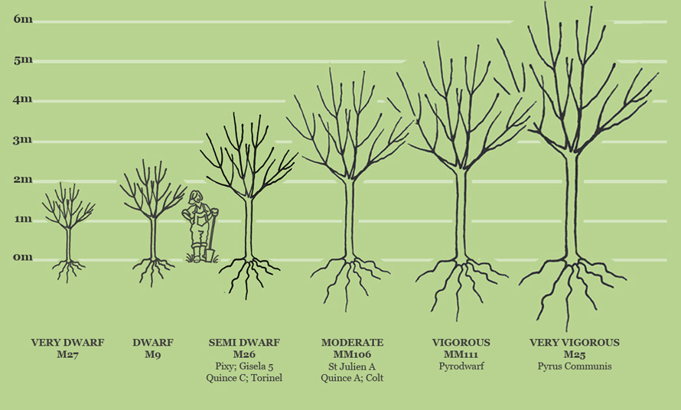
Using dplyr
Recall previous examples; the compensation data are about the production of fruit (apples, kg) on rootstocks of different widths (mm; the tops are grafted onto rootstocks).
Furthermore, some trees are in parts of the orchard that allow grazing by cattle, and others are in parts free from grazing.

Slide 5
Using dplyr
compensation <- read.csv("compensation.csv")
glimpse(compensation) # just checkin’
# get summary statistics for the compensation variables
summary(compensation) #our first check for wonkiness

Slide 6
Using dplyr verbs
Five ‘verbs’ that function to manipulate data:
select() selecting columns
slice() selecting rows
filter() selecting subsets of rows
arrange() sorting rows
mutate() creating new variables
These are core functions for core activities centered on grabbing pieces of, or sub-setting your data
The key is to remember that the first argument to ALL dplyr functions is the name of the data frame.
Notes:
First three are for subsetting.
https://jules32.github.io/2016-07-12-Oxford/dplyr_tidyr/

Slide 7
select()
First you need to know names of columns to select:
names(compensation)
Select a single column:
select(compensation, Fruit) # use the Fruit column
Note: If you get an error Error: could not find function "select" then you have either not put library(dplyr) at the top of your script, or have not run that line of code (activated library).
select(compensation, -Root) # that is a minus sign; selects all columns except the Root column (Fruit and Grazing)

Slide 8
slice()
It works by returning specific row numbers you ask for.
You can ask for one row, a sequence, or a discontinuous set.
slice(compensation, 2) #returns data from second row
slice(compensation, 2:10) #returns data from rows 2-10
slice(compensation, c(2, 3, 10)) #returns rows 2, 3, and 10; uses a helper function c() to collect the rows.
One thing you may notice about slice() is that it also returns a data frame, but it does not return the row number identity found in the original data. You have new, continuous row numbers. Just be aware.
Notes:
You will see the c() function a lot when picking things from a list.

Slide 9
filter()
Use basic logical and boolean operators (Table 3.1)
First we can check to see which rows meet a criteria without returning a dataframe
with(compensation, Fruit > 80) # ‘look in this data frame, and do what comes next, and then stop looking’ (do not make data frame); 9 rows meet this criteria and are returned TRUE.
filter(compensation, Fruit > 80) #returns data frame
Notes:
You will see the c() function a lot when picking things from a list.

Slide 10
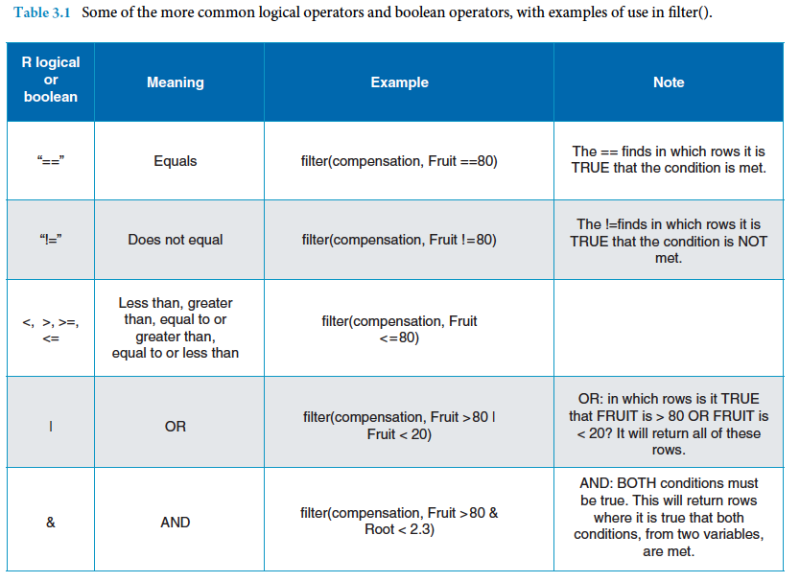

Slide 11
filter()
filter(compensation, Fruit > 80 | Fruit < 20)
One you have returned the subset of interest, assign the data frame to an object for further use
lo_hi_fruit <- filter(compensation, Fruit > 80 | Fruit < 20)
# now look at it
lo_hi_fruit
Important: assign the values returned by subsetting operators [select(), slice(), or filter()] to an object (word) if you want to use them again. Object should now appear in ‘Environment’ window of Rstudio.
The next two operators [arrange() and mutate()] are for manipulating data rather than picking data from an existing data frame.
Notes:
Note spaces between new object, assignment arrow, and commands

Slide 12
What should my script file look like so far? Does it flow logically?
# my first dplyr script; Name, Date, etc.
# clear R's brain; not necessary if using a Rstudio Project
rm(list=ls())
# libraries I need for this script (no need to install...)
library(dplyr)
library(ggplot2)
# get the data
compensation <- read.csv('compensation.csv’)
# quick summary
summary(compensation)
# using dplyr; always takes and gives a data frame
# columns
select(compensation, Fruit) # gets the Fruit column
select(compensation, -Root) # take Root column out from data
# rows
slice(compensation, c(2,3,10)) # get 2nd, 3rd & 10th rows
# gets rows for each condition, and assigns to an object
lo_hi_fruit <- filter(compensation, Fruit > 80 | Fruit < 20)
# run this to see what the above line 'saved' for later use.
lo_hi_fruit
Notes:
Note spaces between new object, assignment arrow, and commands
Note white space (blank lines) between sections of commands

Slide 13
mutate()
As with all dplyr functions . . . mutate() starts with the data frame in which the variables reside, and then designates a new column name and a specific operation to execute.
Often used for data transformations (log transform) and simple calculations from existing data frame variables (e.g. BMI = height/weight, or se = sd/sqrt(n))
We will make this new column appear in our working data frame by employing a neat trick, assigning the values returned by mutate() to an object of the same name as the original data. We are overwriting the data frame (but original data remain untouched; our .csv file)

Slide 14
mutate()
# what does ‘compensation’ look like currently?
head(compensation)
#log transform the Fruit variable
compensation <- mutate(compensation, logFruit = log(Fruit)) #makes new transformed column, overwrites dataframe
# what does ‘compensation’ look like after the mutate
head(compensation)
Reminder: We are working with a copy of our data inside R, manipulating these data, but at no time are we altering the original raw data. You can always go back to those (.csv file) if you need.

Slide 15
arrange()
Put the observations (rows) of our data in a particular order (i.e. to sort them)
Some types of time series analyses need the data in the correct temporal order (and may not themselves ensure this)
arrange(compensation, Fruit) #default is ascending
arrange(compensation, -Fruit) #sorts descending order
Can sort by multiple criteria
arrange(compensation, Grazing, Fruit)
#sorts Grazed group from L-H, then Ungrazed L-H
Notes:
SORT command already taken by BaseR to sort vectors

Slide 16
You can use multiple dplyr verbs in one line
More efficient (but maybe less readable) than having consecutive operations
# Root values from Fruit > 80 subset
select(filter(compensation, Fruit > 80), Root)
first operation
second operation
Reading this from the inside out helps. We’ve asked for dplyr to filter() the data first, then take the data frame from filter(), and use select() to get the Root column only.
Notes:
Takes practice to learn to read order of operations.

Slide 17
You can use ‘pipes’ to nest functions
In R, the pipe command is %>%. You can read this like ‘put the answer of the left-hand command into the function on the right’.
Becomes a logical flow of operators and requires less coding.
Let’s translate the previous two-function code into ‘piped’ commands; remember to always start with the data frame
# Get Root values from Fruit > 80 subset
compensation %>% filter(Fruit > 80) %>% select(Root)
# use this data---------then do this------then do this
Notes:
Returns the 9 out of 40 observations that meet both criteria

Slide 18
Calculating Summary Statistics From Grouped Data
Whenever you have structure, or groups, you can generate some easy and fast summary information.
The two key dplyr functions for this are group_by() and summarise().
We also introduce the functions mean() and sd() (standard deviation).
Steps to Summarize
1. Declare the data frame and the grouping variable.
2. Provide mathematical function for summarizing the data (e.g. mean() or sd()).
3. Provide a nice name for the values returned.
4. Make R use all of this information.

Slide 19
Summary Stats: Method 1: Nested, No Pipe
# for each level of grazing tell me the average # of fruits
summarise(
group_by(compensation, Grazing),
meanFruit = mean(Fruit))
The group_by() function works with the data frame and declares Grazing as the grouping variable.
For more than one consecutive grouping variable, we add comma between them.
Notes:
https://jules32.github.io/2016-07-12-Oxford/dplyr_tidyr/

Slide 20
Summary Stats: Method 2: Pipe, No Nesting
It is perhaps more logical in flow. As always, we start by declaring the data frame.
One big difference is that summarise() is now third in the list, rather than on the ‘outside’.
Start with the data, divide it into groups, and calculate the mean of the fruit data in each group.
compensation %>%
group_by(Grazing) %>%
summarise(meanFruit = mean(Fruit))
#How many levels of Grazing are there?
#Which operators can be used to find out?

Slide 21
Summarizing and Extending Summarization
Ask for more than one statistic (metric) at a time
compensation %>%
group_by (Grazing) %>%
summarise(
nFruit = n(), #note empty parenthesis
meanFruit = mean(Fruit),
sdFruit = sd(Fruit))
This is much more realistic for typical data analysis
Practice: Assign above to object and View (few ways to do it); starting to look like a thesis Table.
Notes:
Note that you can use British English or American English for most common tidyverse commands

Slide 22
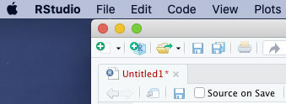
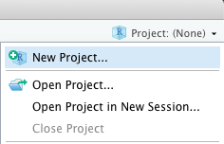
Lets Practice.
First, we need to make a new Project folder. You have been successful when a .Rproj file is listed in the folder contents (files tab of lower right panel).
Make a new script file (.R) and save it in the project folder
Load the dplyR library by putting it at the top of the script as one of the first commands.
#C.M. Gienger
#My sweet sweet practice script
library(dplyr)
Type the commands in order to produce a completely repeatable workflow. Lets get a look at the data...
mtcars

Slide 23


Practice with mtcars
mtcars #displays data; 11 variables with 32 obs. each
#mtcars is a dataset built-in to R; no need to import data
#First column of mtcars lists car names, but column is not #indexed (not a recognized part of dataframe)
#There is a simple fix using dplyR
mtcars <- mtcars %>%
tibble::rownames_to_column()
mtcars #displays formatted data; 12 variables 32 obs.
#first column labeled rowname; rows also now indexed with row numbers
?mtcars #lets see what those variable names mean
Notes:
Keep row names to use as a variable:
https://stackoverflow.com/questions/45868766/select-mtcars-dataset-start-with-name-with-letter-m

